Slide 1
Travel Time Problem
CE En 547

Slide 2
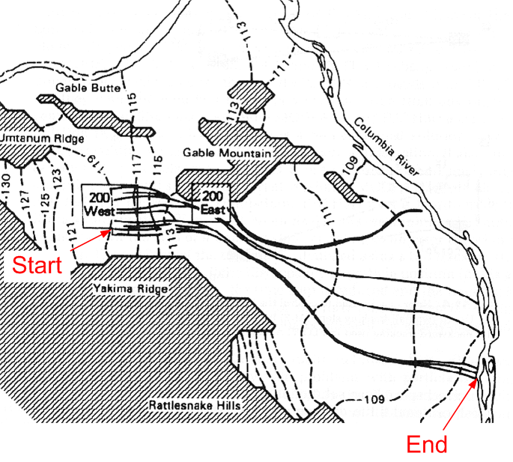
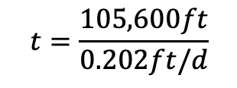
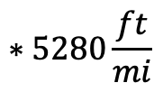
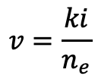





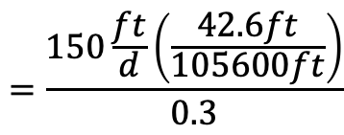
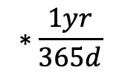
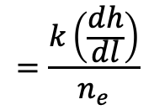

Travel Time Problem
head change = dh
= ~ 119-106 = 13m
$$∗3.28\frac{ft}{m}$$
= 42.6 ft
distance = dl = 20mi
$$∗5280\frac{ft}{mi}$$
= 105,600 ft
$$=\frac{k\left(\frac{dh}{dl}\right)}{n_{e}}$$
$$=\frac{150\frac{ft}{d}\left(\frac{42.6ft}{105600ft}\right)}{0.3}$$
$$v=\frac{ki}{n_{e}}$$
$$=0.202ft/d$$
$$v=\frac{x}{t}$$
$→$ $t=\frac{x}{v}$
$$t=\frac{105,600ft}{0.202ft/d}$$
$$∗\frac{1yr}{365d}$$
$$=523,538d$$
$$=1434yrs$$

